Slide 1
Lecture 27 November 6th , 2019
Any questions on the flies?
This week, you will need to clear out parent flies so as F1 emerge, we are not mistakenly analyzing parents or mating parents with F1. As soon as you see pupae, do this.
When you see 20+ flies in your cleared vials, you can make new media vials and simply tap some into the new vials. You will likely tap in some males and some females. When each student has 2-4 F1XF1 vials, they will use the rest to analyze the offspring. Record F1 male and female phenotypes.

Slide 2
Where were we?…
Linked genes---how do we recognize that 2 genes are linked? Describe how we might recognize that pea color gene and pea texture gene are linked?
Start simple---what might you do?
What makes genes completely linked?
What is the relationship between linked gene distance and frequency of crossing over?

Slide 3
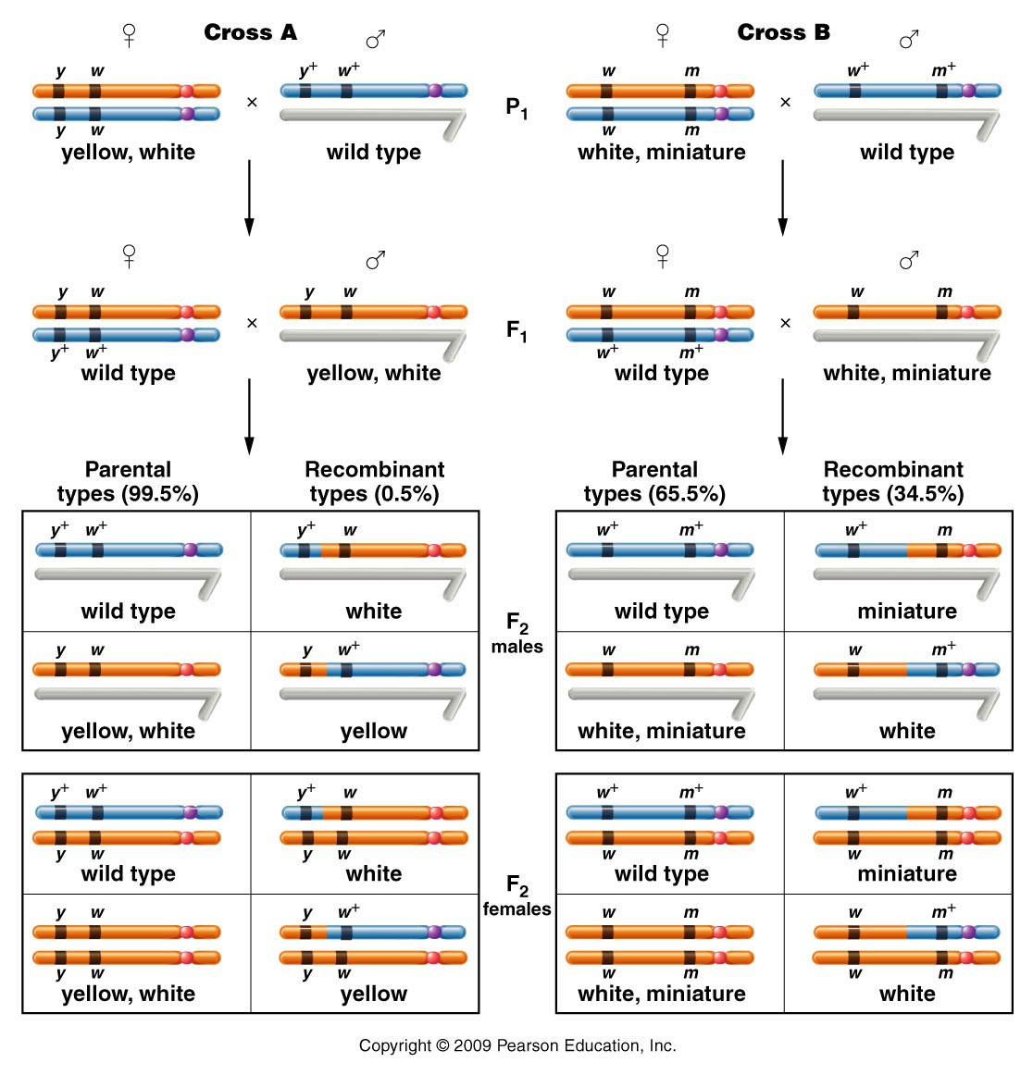
Figure 5.3
Notes:
3
Figure 5-3 The F1 and F2 results of crosses involving the yellow-body, white-eye mutations and the white-eye, miniature-wing mutations. In cross A, 1.3 percent of the F2 flies (males and females) demonstrate recombinant phenotypes, which express either white or yellow. In cross B, 37.2 percent of the F2 flies (males and females) demonstrate recombinant phenotypes, which are either miniature or white mutants.

Slide 4
Important observation…
A dihybrid cross involving linked genes will usually result in 4 different combinations of traits, but not give a 9:3:3:1 ratio of offspring.
These 2 genes definitely did not appear to assort independently—different ratios were seen—different in every gene pair examined as well.

Slide 5
Sturtevant’s conclusion:
1) linked genes do physically separate as a result of crossing over during meiosis
2) Different crossing over/recombination frequencies reflect physical distances between loci.
3) Closely spaced genes are less likely to undergo crossing over.

Slide 6
Distances determined by recombination frequencies are not actual physical distances, but do reflect relative distances between genes.
Units are centiMorgans (cM) or map units (mu)

Slide 7
Morgan’s data was used to create a map showing the relative distance between the genes.
Aa
**The two, 2-point crosses would not show order, unless all combinations of genes were analyzed.
Figure 5.4
Notes:
Figure 5-4 A map of the yellow (y), white (w), and miniature (m) genes on the X chromosome of Drosophila melanogaster. Each number represents the percentage of recombinant offspring produced in one of three crosses, each involving two different genes.

Slide 8
Applying the concepts…
Is this the only map possible?
How could we be certain of the exact order of the genes? (basically make sure a specific gene is in the middle of the 3?)

Slide 9
Quick summary…linked genes
We’ve defined linked genes.
We’ve noted that independent assortment does not occur, with linked genes.
We’ve noted that linked alleles can separate if crossing over occurs between them.

Slide 10
Crossover occurs more frequently, the farther apart 2 genes are on the same chromosome.
A b C
a B c

Slide 11
The frequency in which crossover is noted, becomes a recombination gene distance (in cM or mu
A b C
a B c
Perhaps we see recombinant offspring due to a-b crossover 2% of the time and b-c, 35 % of the time.

Slide 12
The frequency in which crossover is noted, becomes a recombination gene distance (in cM or mu)
A b C
a B c
2 cM
35 cM

Slide 13
Note---Crosses must be carefully designed to be able to observe crossing over. (X-linked traits simplify the analysis)
1 parent must be heterozygous
1 parent must provide only recessive alleles so that new combinations of wt/recessive traits are evident.

Slide 14
Heterozygous female
Male with only recessive alleles
Figure 5.3
Notes:
Figure 5-3 The F1 and F2 results of crosses involving the yellow-body, white-eye mutations and the white-eye, miniature-wing mutations. In cross A, 1.3 percent of the F2 flies (males and females) demonstrate recombinant phenotypes, which express either white or yellow. In cross B, 37.2 percent of the F2 flies (males and females) demonstrate recombinant phenotypes, which are either miniature or white mutants.

Slide 15
Morgan’s crosses were simplified in 2 ways:
1. Using X-linked crosses in Drosophila meant that crossing over was only possible in females. (2 X chromosomes)
2. In Drosophila, males do not engage in crossing over at all so looking at recombination of any linked genes is simplified.

Slide 16
Morgan’s student, Alfred Sturtevant saw an immediate application to recombination mapping.
Determination of linear sequence of genes on a chromosome.

Slide 17
Sturtevant noted that recombination frequencies were approximately additive, allowing the order of genes to be determined.
In 3 separate crosses:
y-w frequency is 0.5%
w-m frequency is 34.5
y-m frequency is 35.4 %

Slide 18
Sturtevant noted that recombination frequencies were approximately additive, allowing the order of genes to be determined.
In 3 separate crosses:
y-w frequency is 0.5%
w-m frequency is 34.5
y-m frequency is 35.4 %
**Which genes are on the outside?
*** Which gene is in the middle?
****Which genes are closest to each other?

Slide 19
Sturtevant’s data was used to create a map showing the relative distance between the genes AND order.
The data is not exactly additive (because chance deviation occurs in the experiment)…
But also because further 2 genes are spaced the less accurate recombination mapping becomes (explained later)
Figure 5.4
Notes:
Figure 5-4 A map of the yellow (y), white (w), and miniature (m) genes on the X chromosome of Drosophila melanogaster. Each number represents the percentage of recombinant offspring produced in one of three crosses, each involving two different genes.

Slide 20
A closer look at crossing over
Homologous chromosomes are duplicated and paired in a tetrad of chromatids.
Each chromatid ends up in a different gamete
Crossover can occur between any 2 non-sister chromatids

Slide 21
Crossover is thought to occur at least once in each tetrad during meiosis.
However, the location of the x.o. varies in individual gamets and is only observed if it occurs between genes for which traits are noted to recombine. (you have to be looking for recombination in those traits)

Slide 22
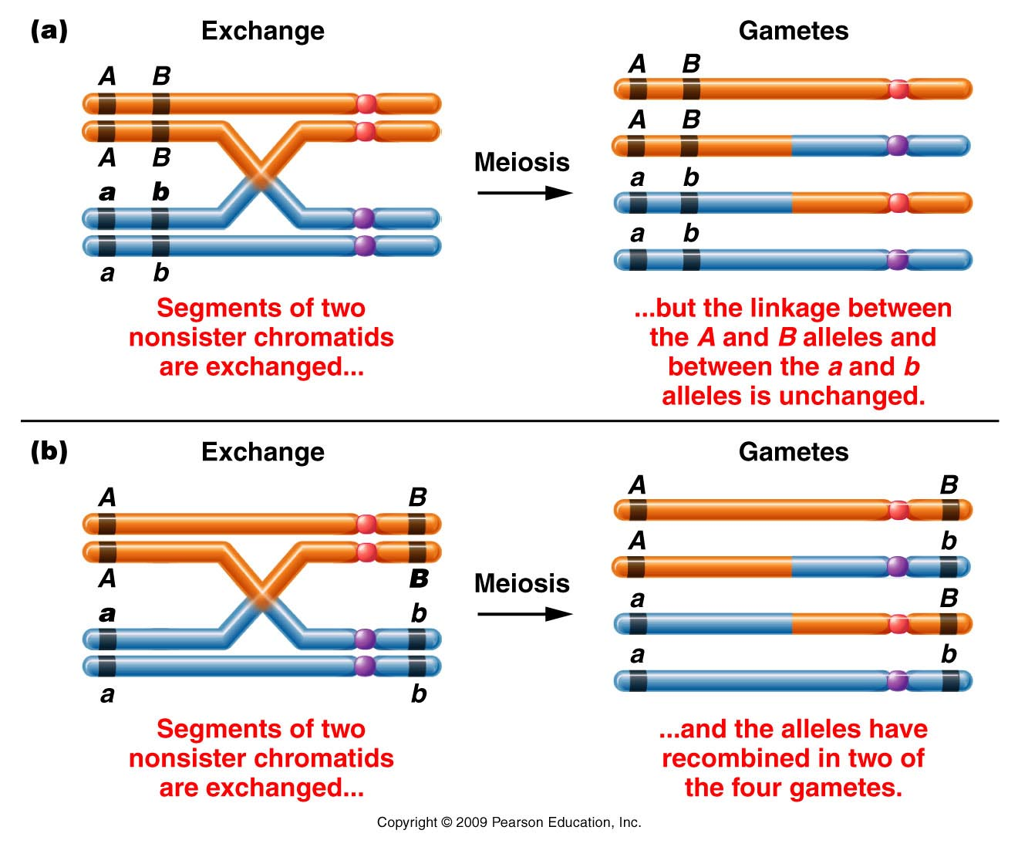
Figure 5.5
Notes:
Figure 5-5 Two examples of a single crossover between two nonsister chromatids and the gametes subsequently produced. In (a) the exchange does not alter the linkage arrangement between the alleles of the two genes, only parental gametes are formed, and the exchange goes undetected. In (b) the exchange separates the alleles, resulting in recombinant gametes, which are detectable.

Slide 23
You would not notice cross over in offspring of this organism if you were studying traits A and B
You would notice cross over in offspring of this organism if you were studying traits A and B
Figure 5.5
Notes:
Figure 5-5 Two examples of a single crossover between two nonsister chromatids and the gametes subsequently produced. In (a) the exchange does not alter the linkage arrangement between the alleles of the two genes, only parental gametes are formed, and the exchange goes undetected. In (b) the exchange separates the alleles, resulting in recombinant gametes, which are detectable.

Slide 24
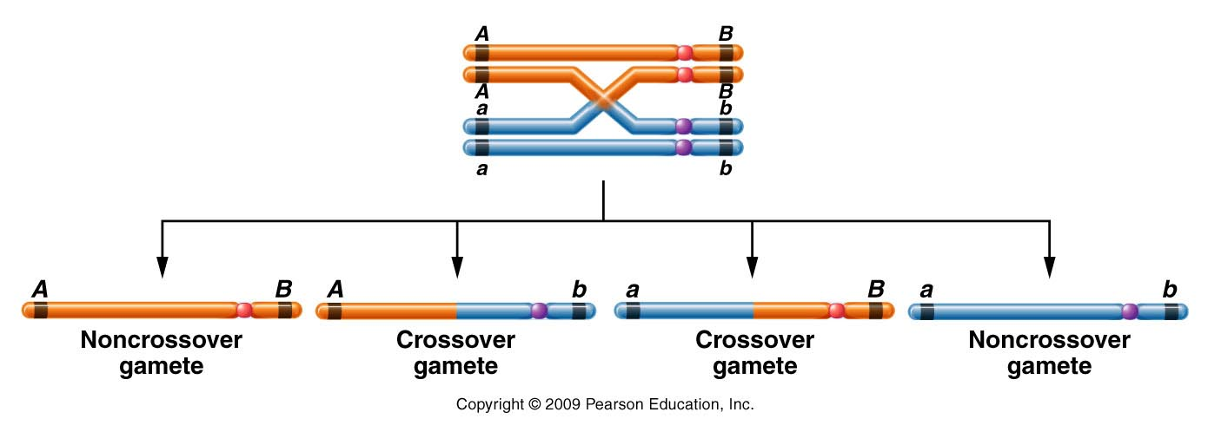
Important concept---for each crossover event, only half of the gametes will show new combinations of alleles.
Figure 5.6
Notes:
Figure 5-6 The consequences of a single exchange between two nonsister chromatids occurring in the tetrad stage. Two noncrossover (parental) and two crossover (recombinant) gametes are produced.

Slide 25
Important concept!
If 2 loci lie very far apart on the same chromosome, we might expect to see nearly all gametes showing that X.O occurred between them.
A
B

Slide 26
Even if X.O. occurs 100% of the time between 2 loci, we only observe 50% recombinant gametes/offspring.
Therefore, using recombination mapping, 2 loci can never appear to be greater than 50 cM apart.

Slide 27
Conclusion?...
As distance between 2 loci increases, recombination frequencies approach , but never exceed 50%. Thus the farther apart 2 loci, the less accurate recombination mapping becomes.

Slide 28
This is a problem!
At some point, linked genes actually appear to be unlinked.
Quick--- review what occurs in independently assorting genes.

Slide 29
In independent assortment, the F1 heterozygote will make 50% recombinant gametes (just like 2 distantly linked genes)
Take home message? When recombination frequencies approach 50%, we don’t know if genes are unlinked, or linked, but very far apart!

Slide 30
Something to ponder…
The garden pea only has 7 chromosomes
Mendel reported inheritance for 7 traits.
When he began to look at traits 2 or more at a time, he always described independent assortment.
For example—9:3:3:1 F2 ratio does not occur unless independent assortment occurs…
How was Mendel so lucky to never encounter linkage? It would have been hard to explain.

Slide 31
He did encounter linkage—but he didn’t know it!!! (page 126) READ!!
We now know lots about the genes controlling those 7 traits including the location of each gene:
Chromosome 4----3 genes/ traits (3 linked genes)
Chromosome 1---2 genes/ traits (2 linked genes)
Chromosome 5---1 gene/ trait
Chromosome 7---1 gene/ trait

Slide 32
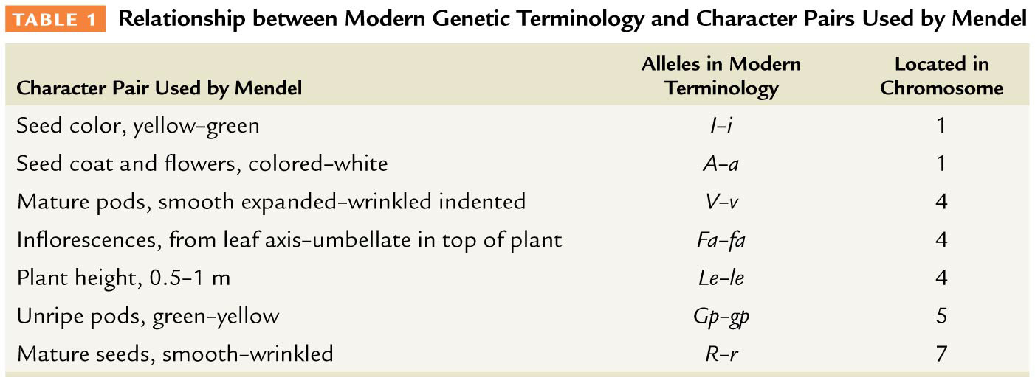
Table 5–1

Slide 33
Why did Mendel only describe independently assorting unit factors?!
For the dihybrid crosses he studied only, those involving linked genes included genes that are so distantly linked on the chromosome that they appear unlinked (~50% recombination)

